Slide 1


Slide 2
PRESENTATION FOR CONSTITUTION OF INDIA
TOPIC : HISTORICAL PRESPECTIVES OF CONSTITUTION OF INDIA
SUBJECT GUIDE : MRS.SUBHA MAM
PRESENTATION BY : AARTHI .B
DEPARTMENT : ARTIFICIAL INTELLIGENCE AND DATA SCIENCE
REGISTER NO: 927621BAD002

Slide 3
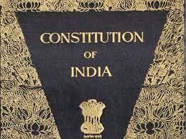

Slide 4
INTRODUCTION
It is a Sovereign Socialist Secular Democratic Republic with a parliamentary system of government. The Republic is governed in terms of the Constitution of India which was adopted by the Constituent Assembly on 26th November, 1949 and came into force on 26th January, 1950

Slide 5
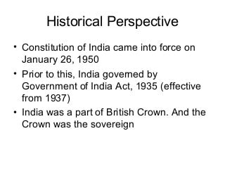
HISTORICAL PRESPECTIVE

Slide 6
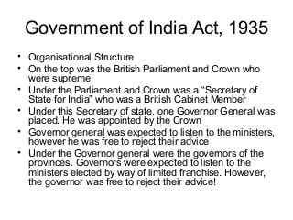
AAA

Slide 7
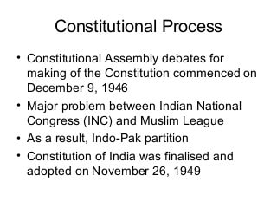
AAA

Slide 8
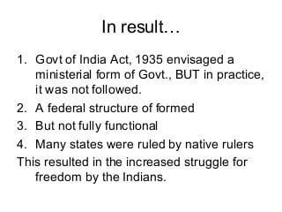
AA

Slide 9
INDO PAK PARTITION
The partition was caused in part by the two-nation theory presented by Syed Ahmed Khan. Pakistan became a Muslim country, and India became a majority Hindu but secular country. The main spokesman for the partition was Muhammad Ali Jinnah. He became the first Governor-General of Pakistan.

Slide 10
FEDERALISM
Federalism in India refers to relationship between the Central Government and the State governments of India.
The powers are shared by the two government
The consititution is RIGID and CODIFIED
There are central and state laws

Slide 11
THANK YOU

